Slide 1

Gameshows Quiz

Slide 3
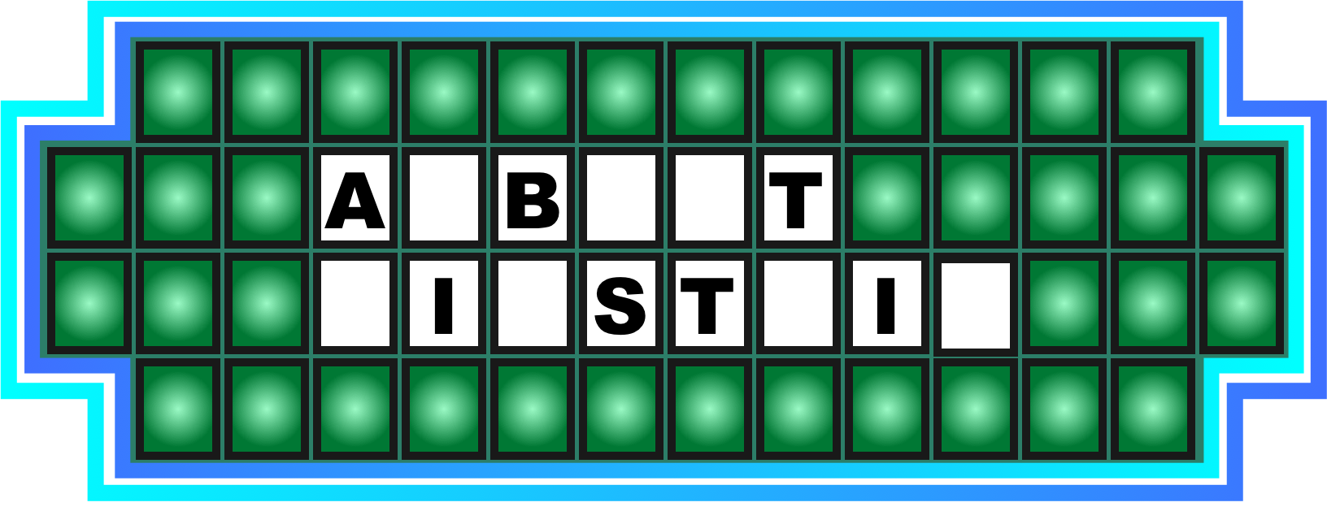
1. A genius

Slide 4
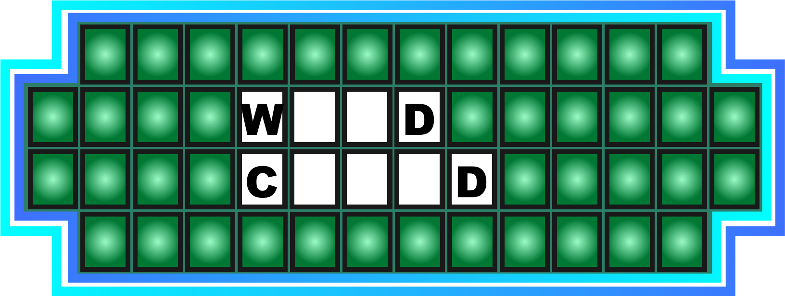
2. Crazy kid

Slide 5
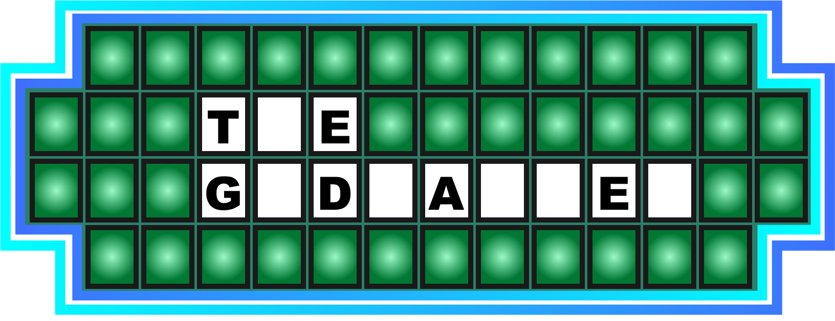
3. An epic movie

Slide 6
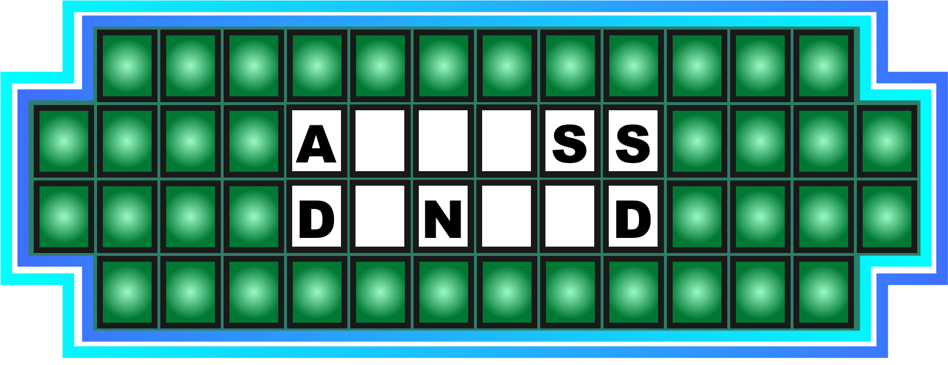
4. Please try again...

Slide 7
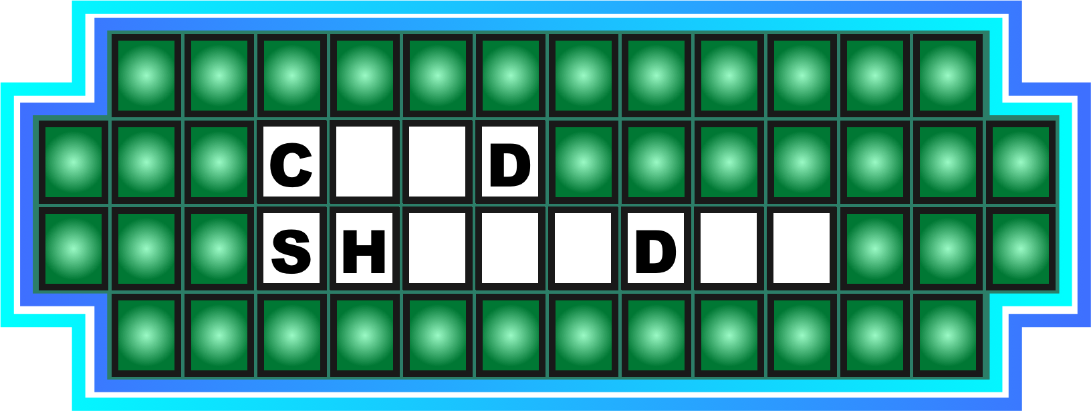
5. Not talking to you...

Slide 8
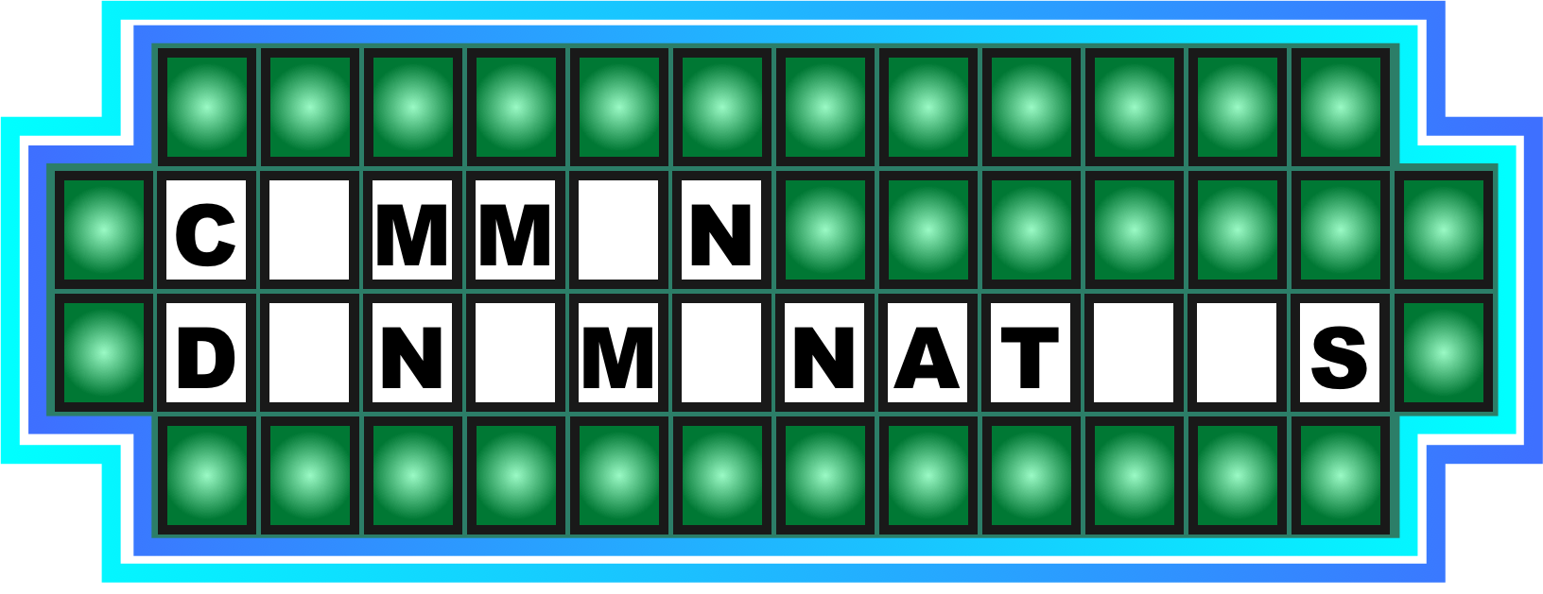
6. They share it

Slide 9
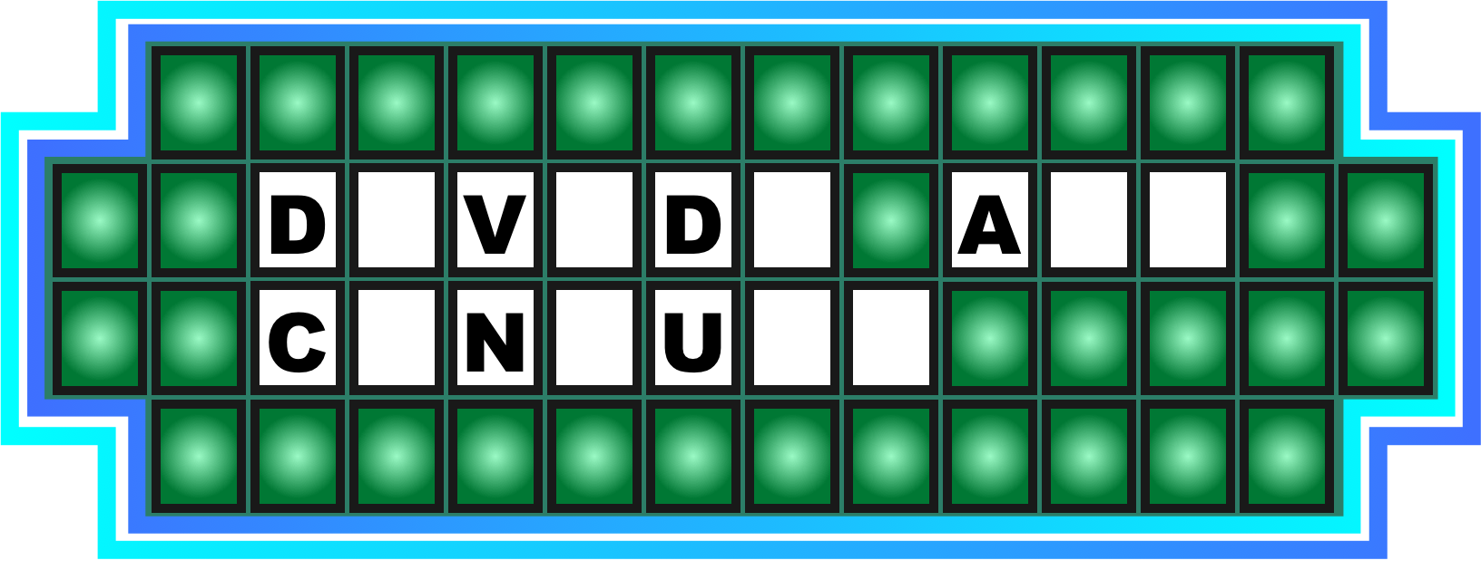
7. Split up and get it done

Slide 10
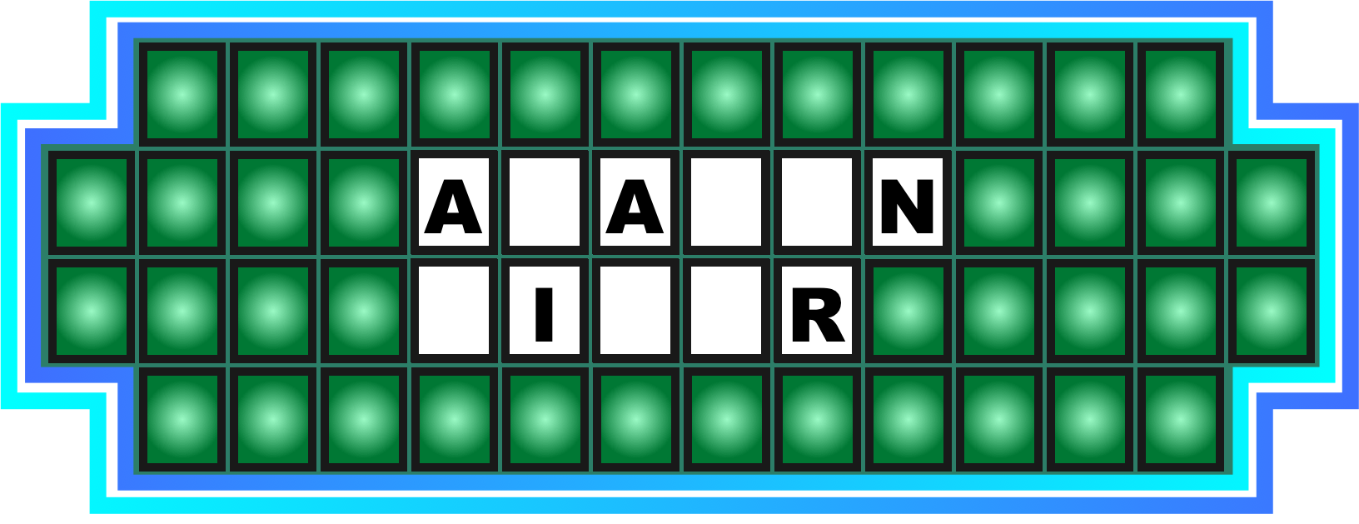
8. It has crocs

Slide 11
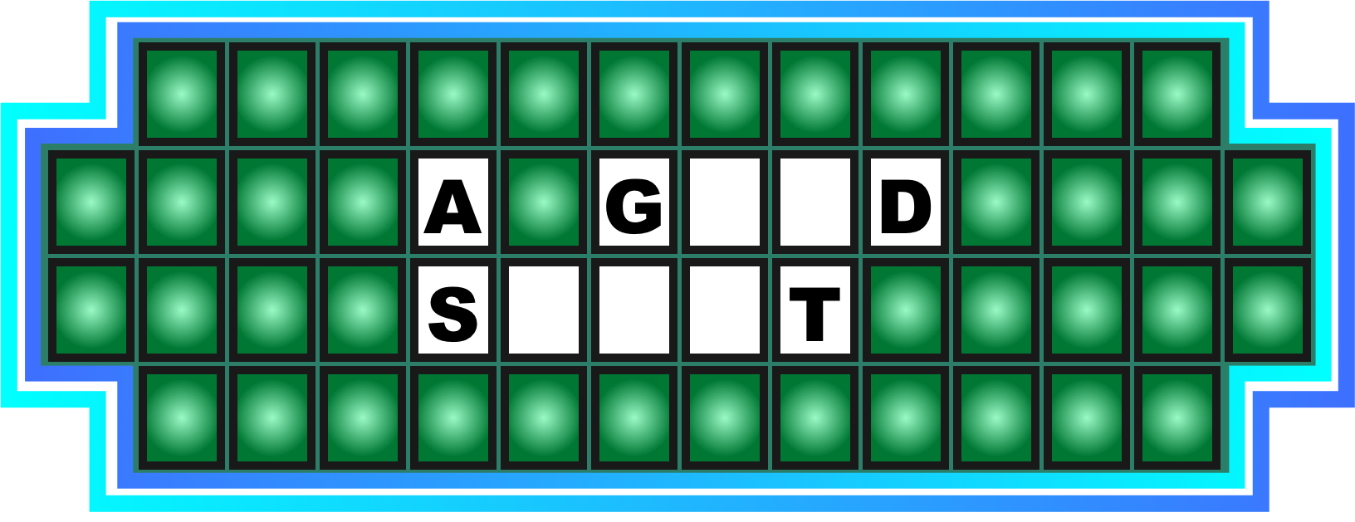
9. Gracious

Slide 12
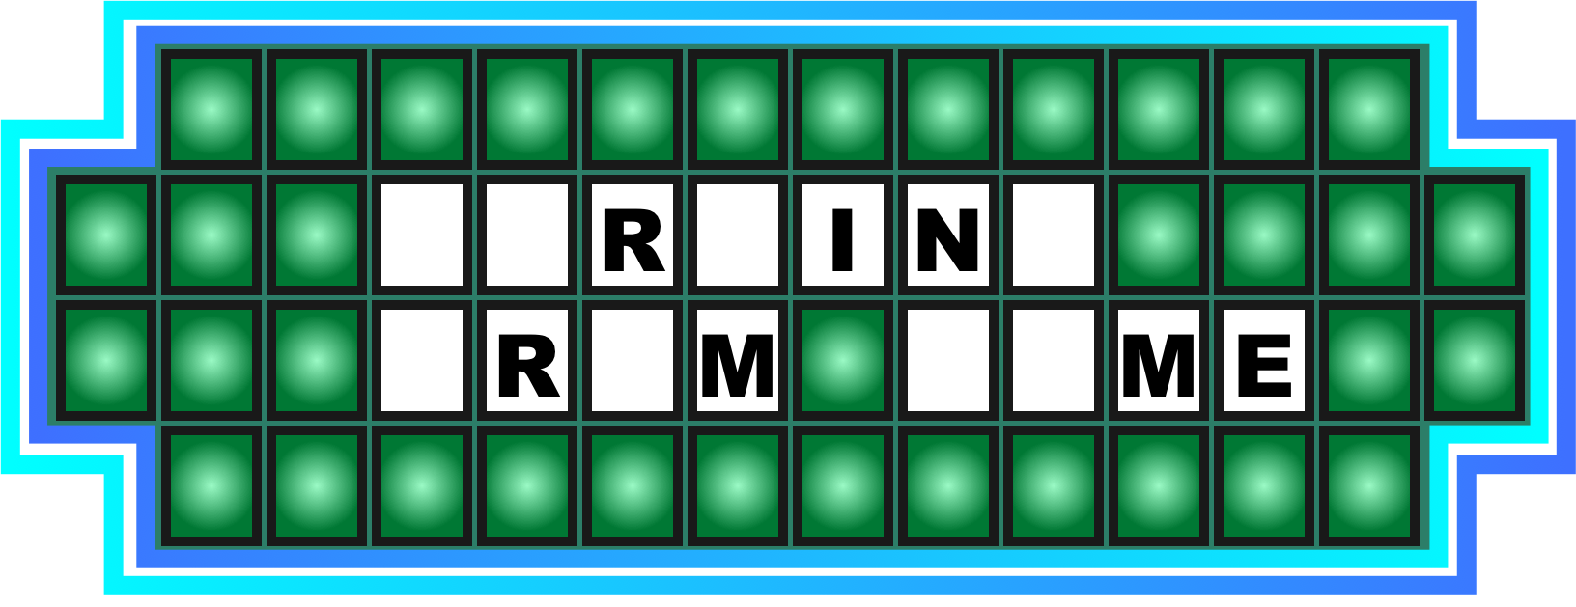
10. A recent trend for many of us

Slide 14
1. A genius

Slide 15
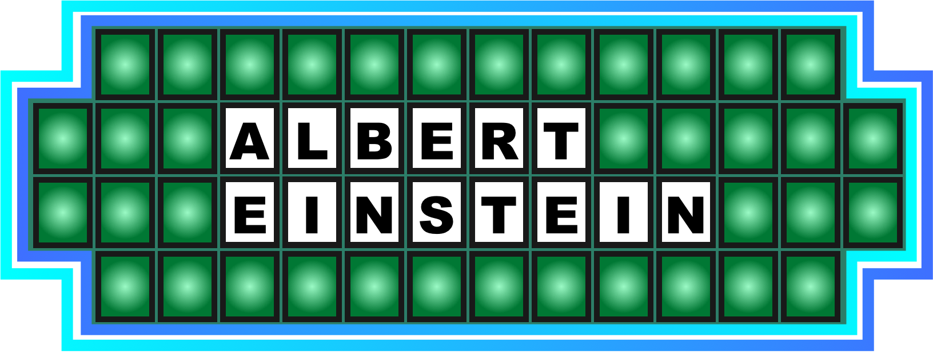
1. A genius

Slide 16
2. Crazy kid

Slide 17
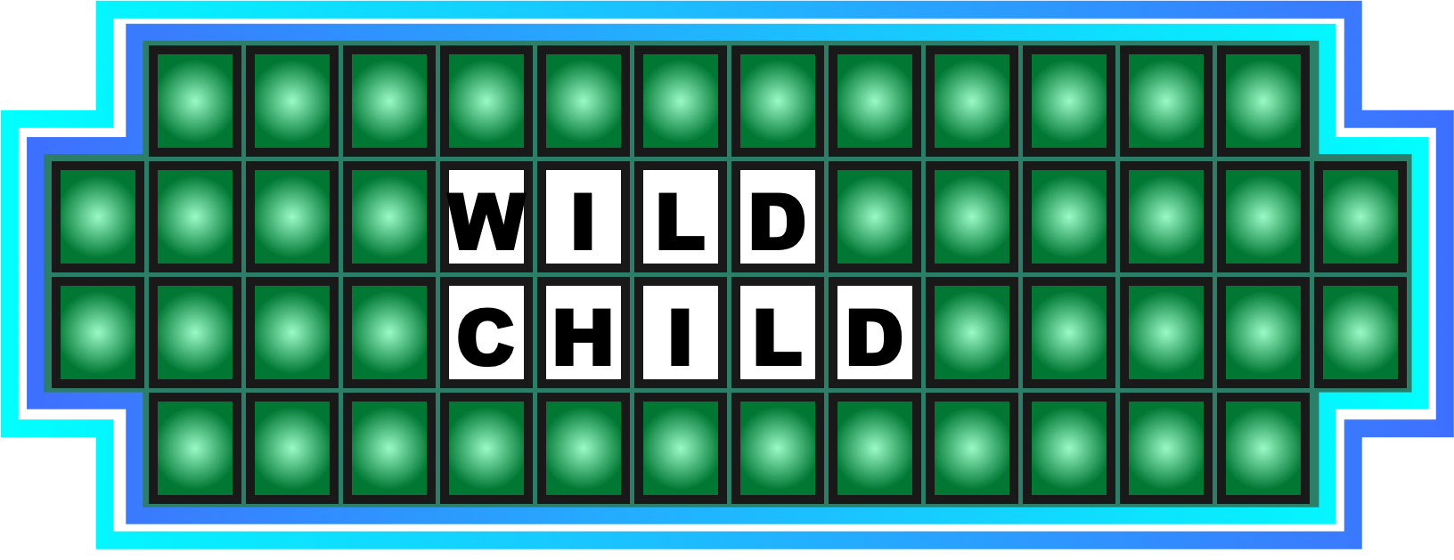
2. Crazy kid

Slide 18
3. An epic movie

Slide 19

3. An epic movie

Slide 20
4. Please try again...

Slide 21
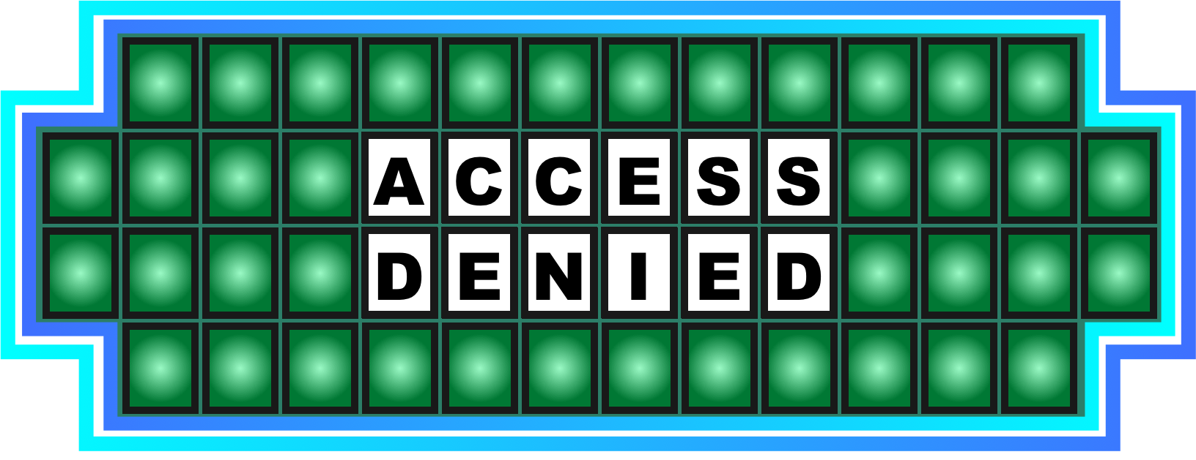
4. Please try again...

Slide 22
5. Not talking to you...

Slide 23
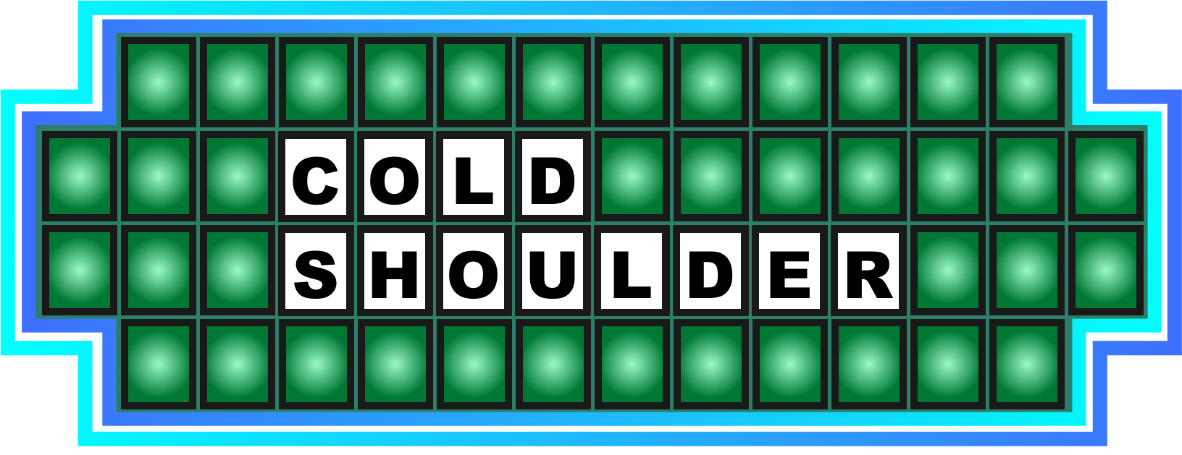
5. Not talking to you...

Slide 24
6. They share it

Slide 25

6. They share it

Slide 26
7. Split up and get it done

Slide 27
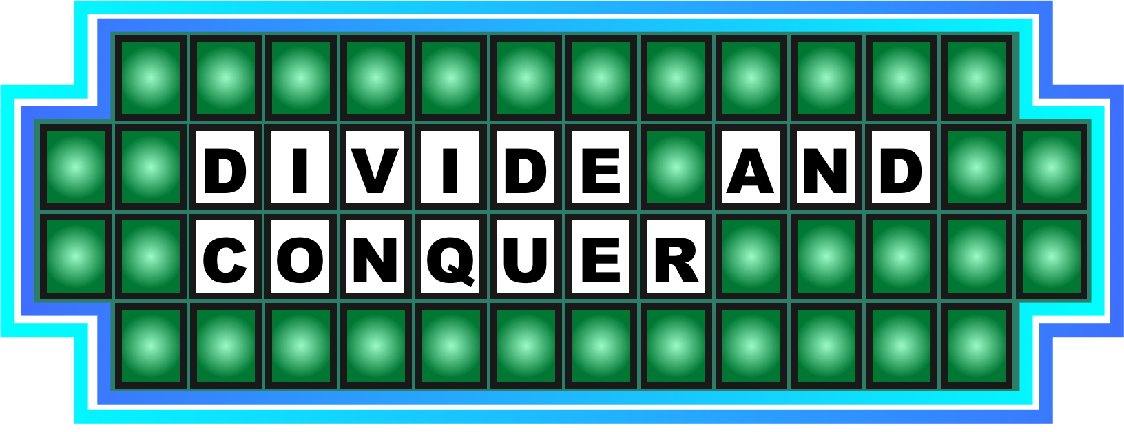
7. Split up and get it done

Slide 28
8. It has crocs

Slide 29
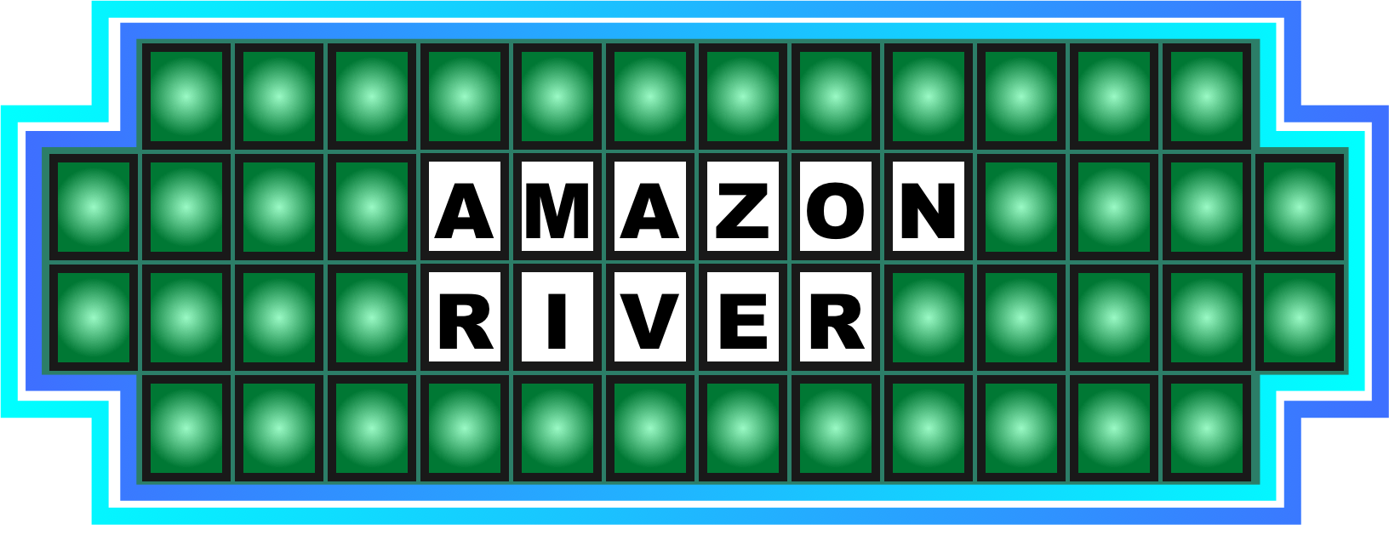
8. It has crocs

Slide 30
9. Gracious

Slide 31

9. Gracious

Slide 32
10. A recent trend for many of us

Slide 33

10. A recent trend for many of us

Slide 35

1. Peter waved goodbye to his dad, and then...

Slide 36

2. You'll see a lot of these at Comic Con

Slide 37

3. Nyccegirls take care of the planet

Slide 38

4. On their way to work

Slide 40
1. Peter waved goodbye to his dad, and then...

Slide 41

1. Peter waved goodbye to his dad, and then...

Slide 42
2. You'll see a lot of these at Comic Con

Slide 43

2. You'll see a lot of these at Comic Con

Slide 44
3. Nyccegirls take care of the planet

Slide 45

3. Nyccegirls take care of the planet

Slide 46
4. On their way to work

Slide 47

4. On their way to work

Slide 49
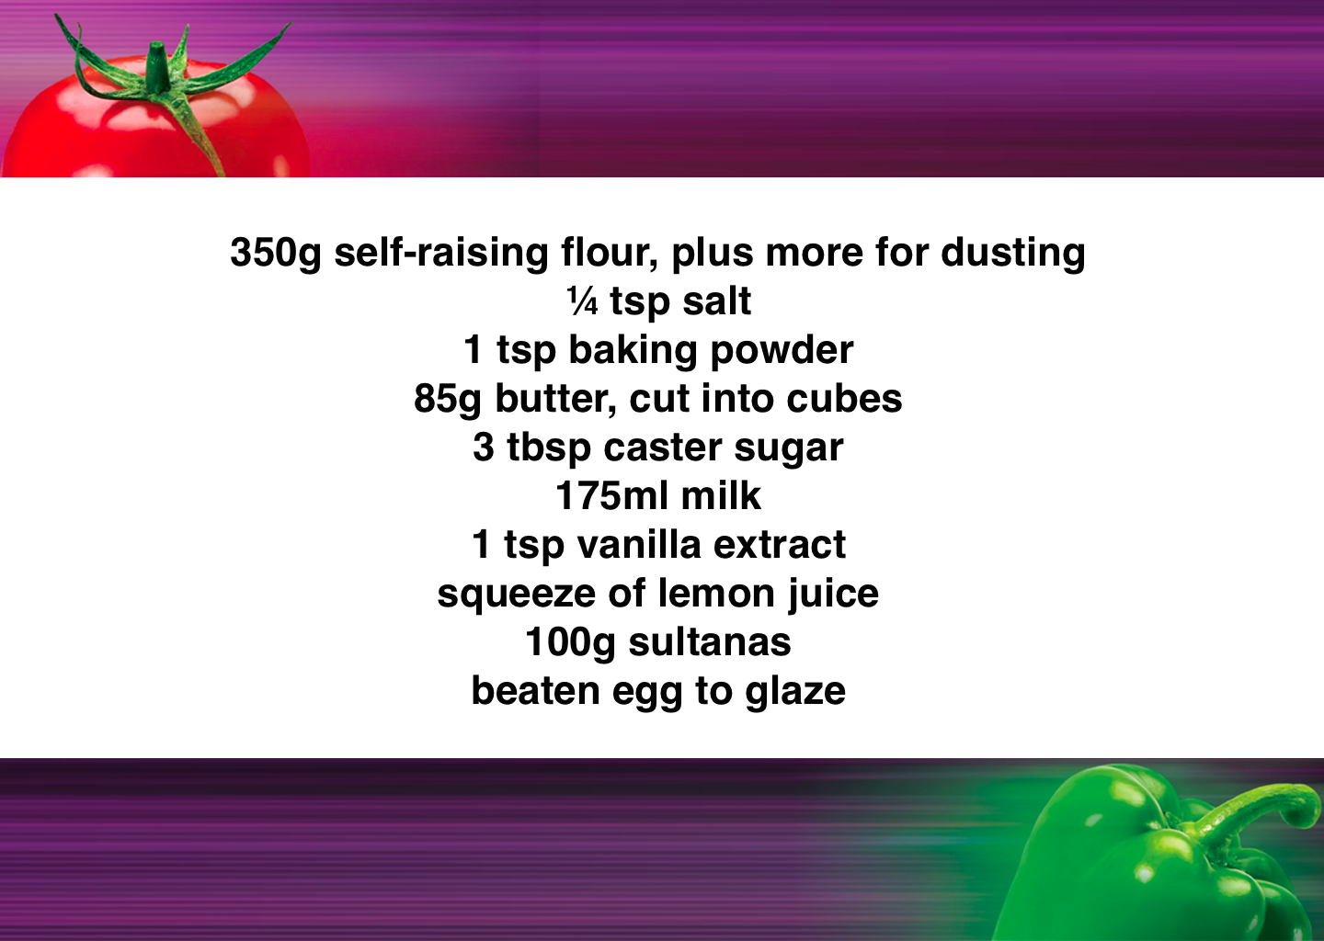

Slide 50
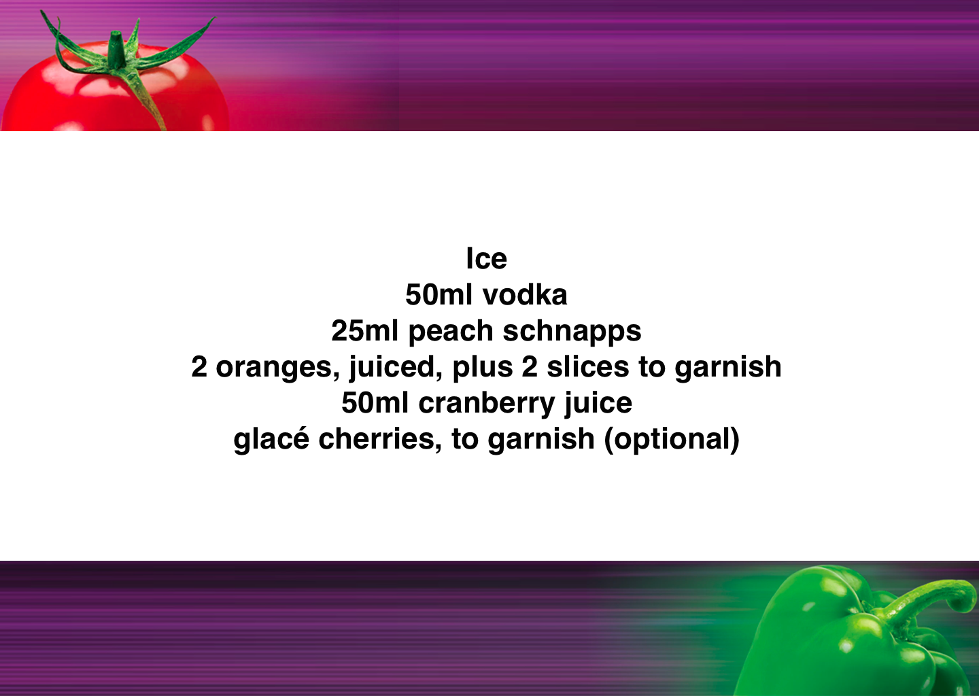

Slide 51
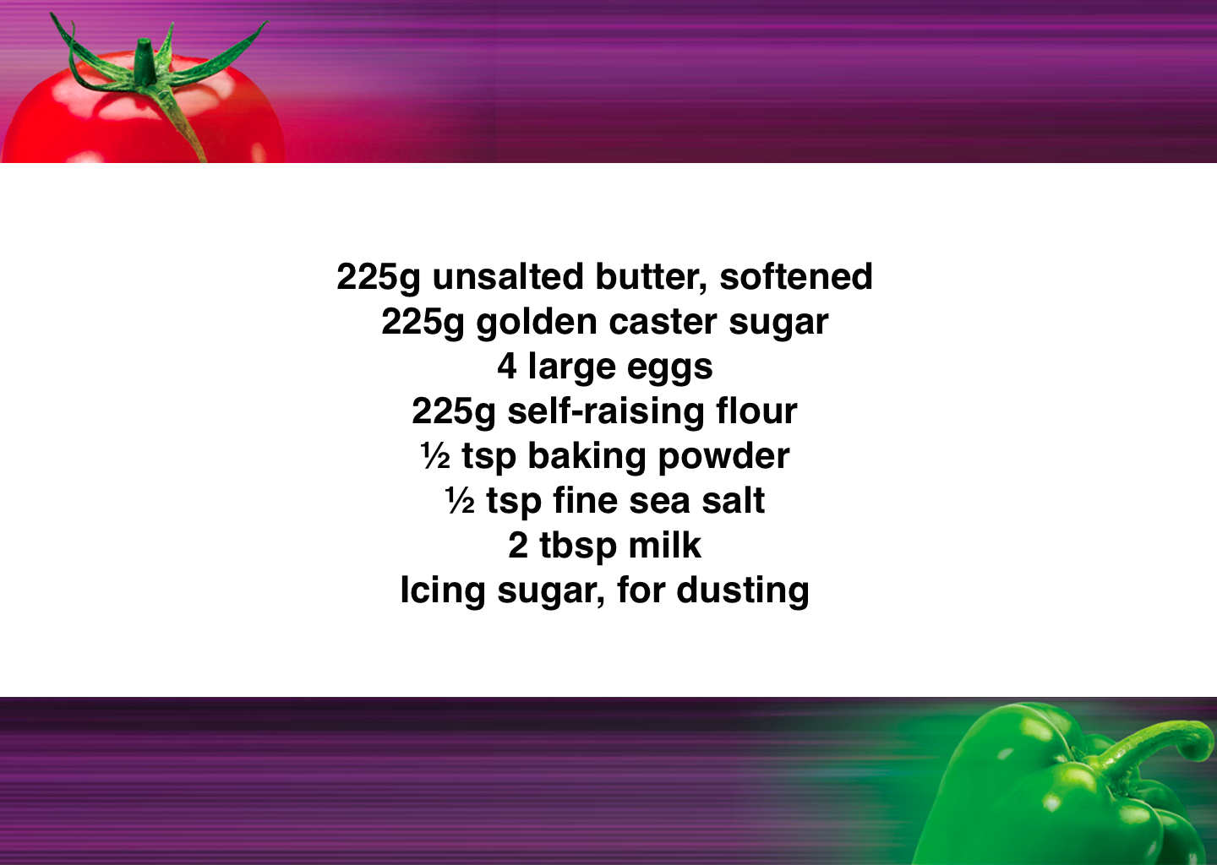

Slide 52
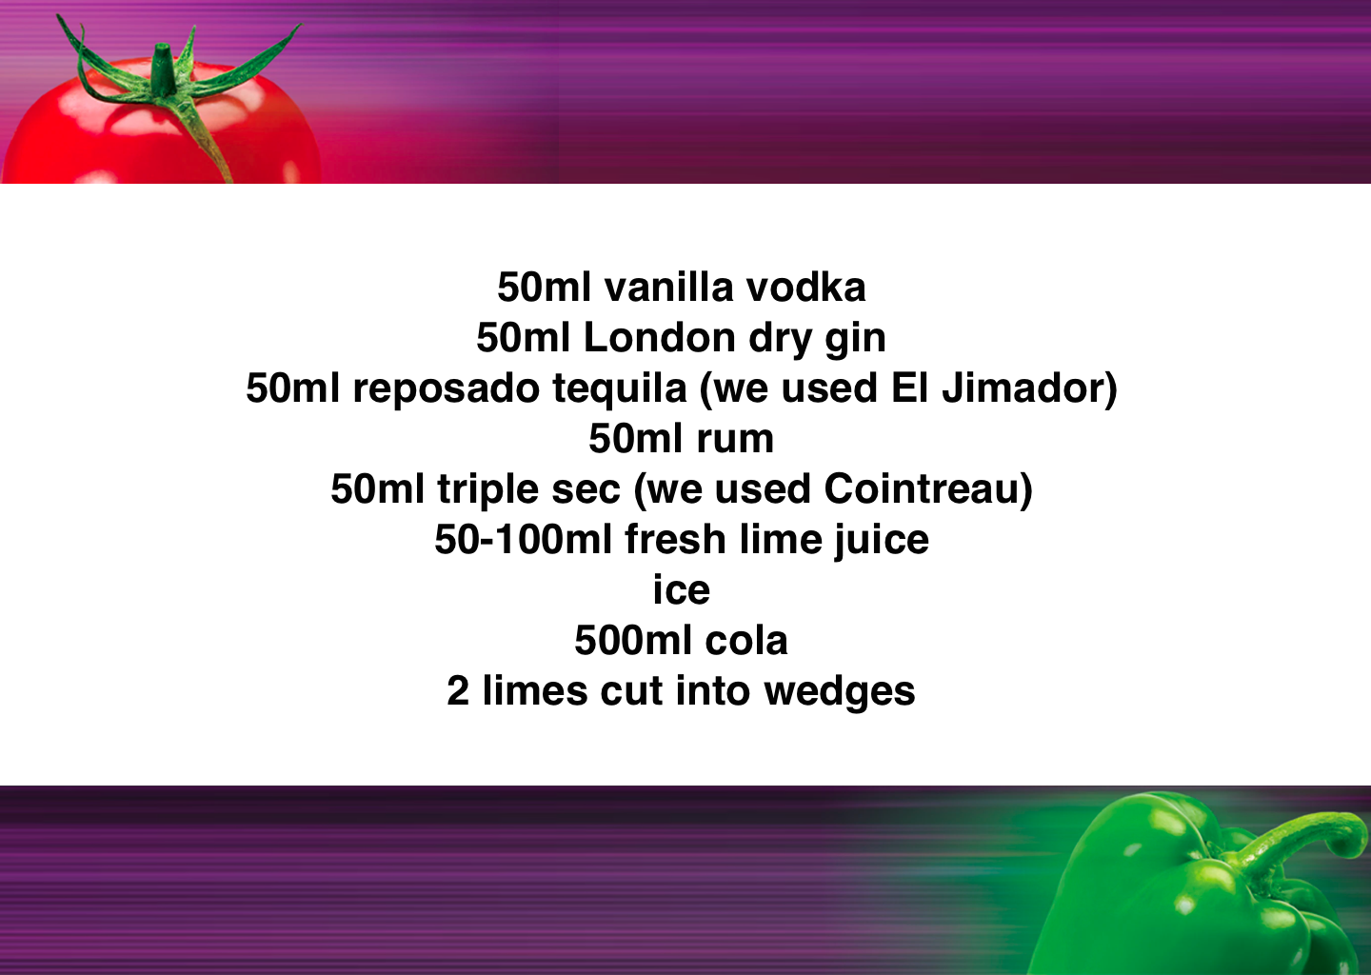

Slide 53
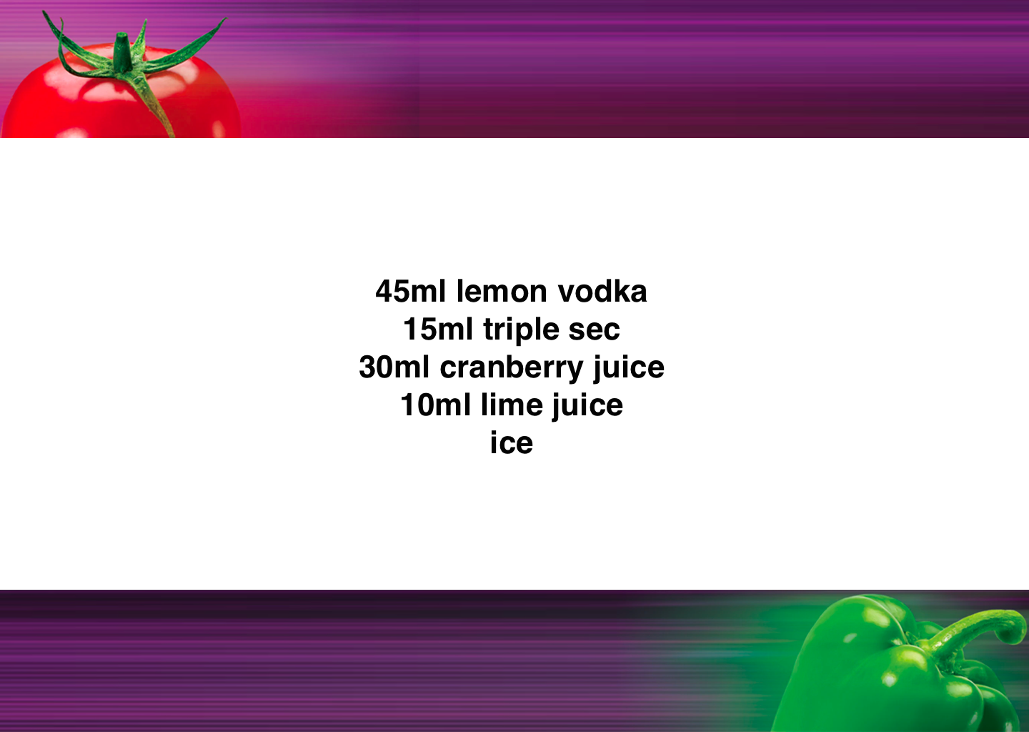

Slide 54
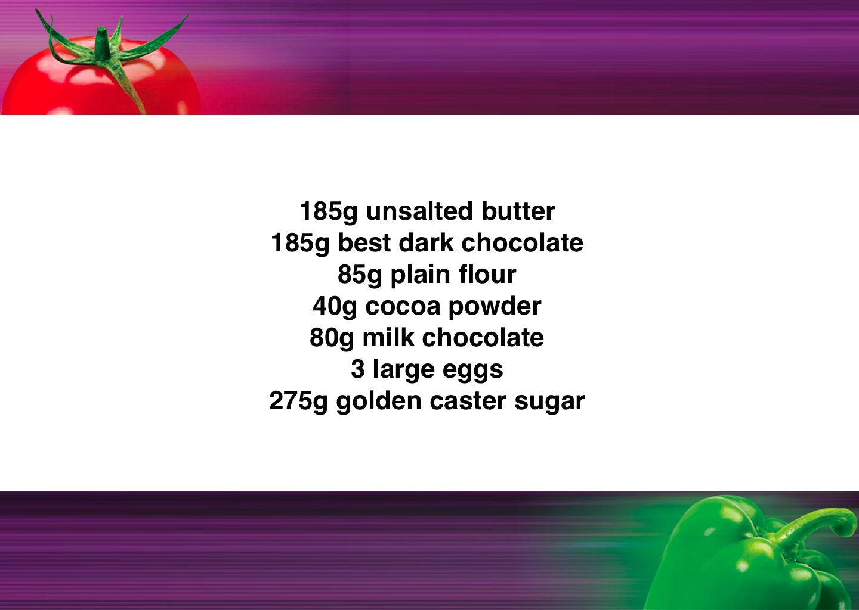

Slide 55
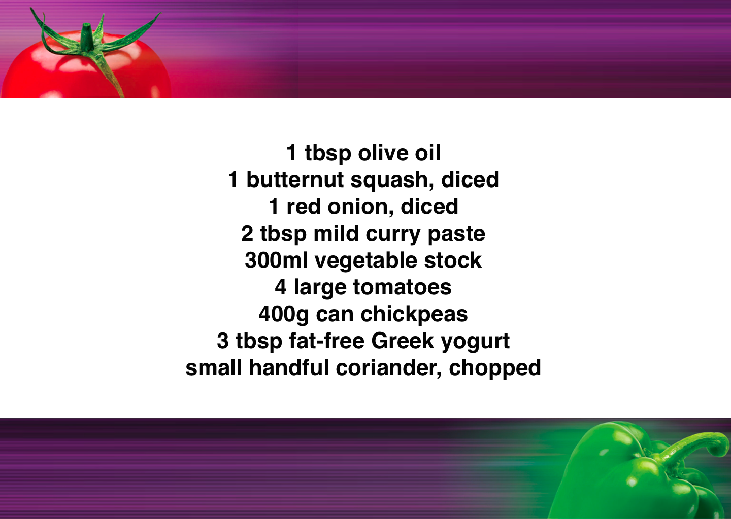

Slide 56
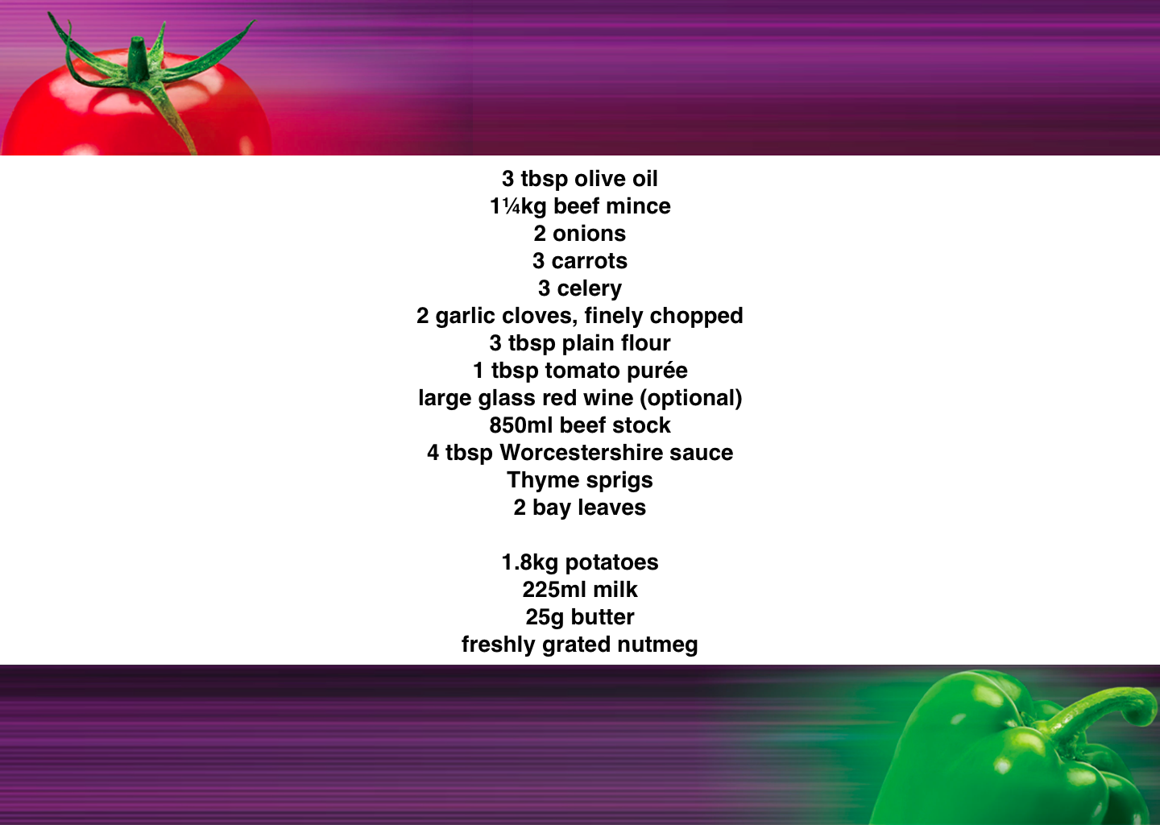

Slide 57
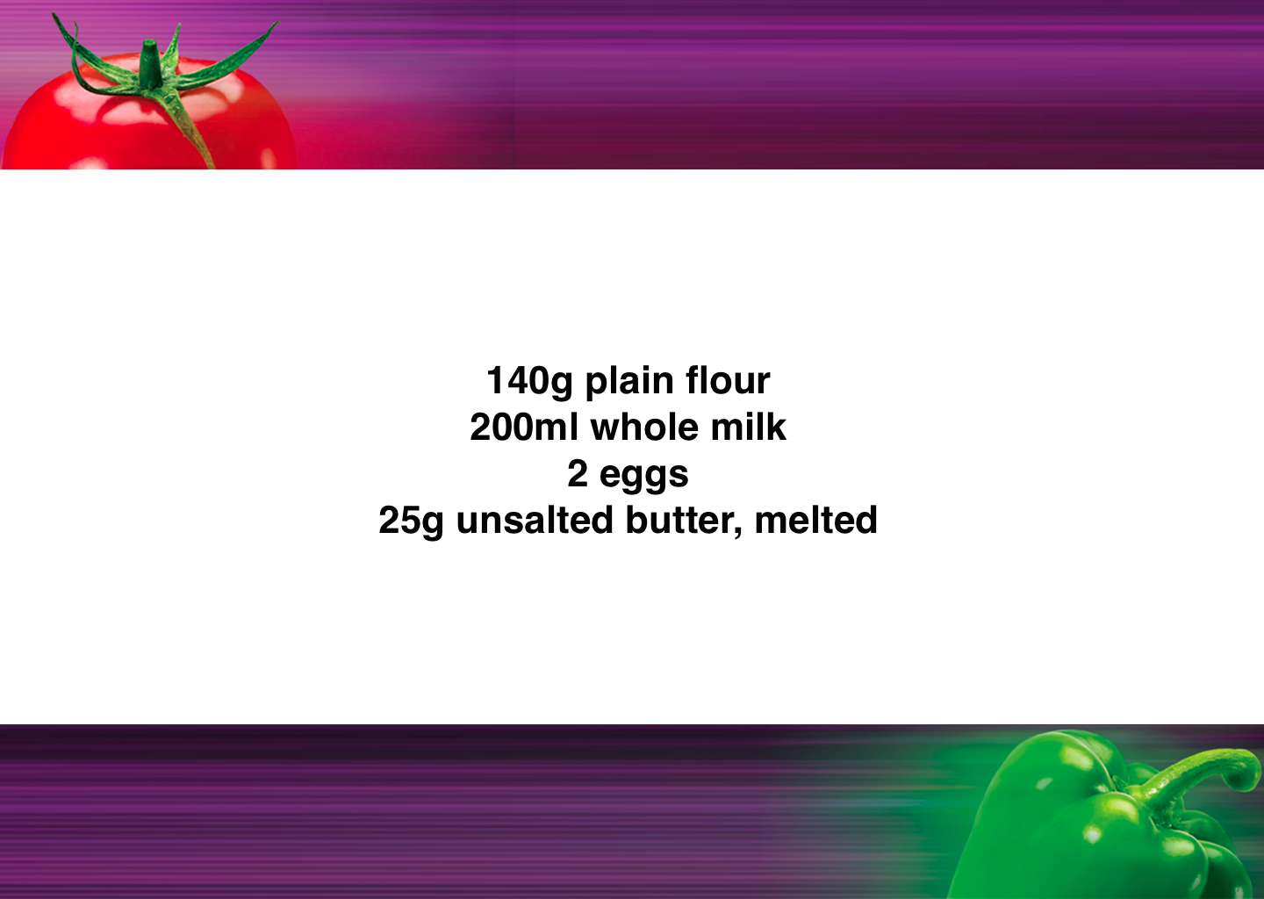

Slide 58
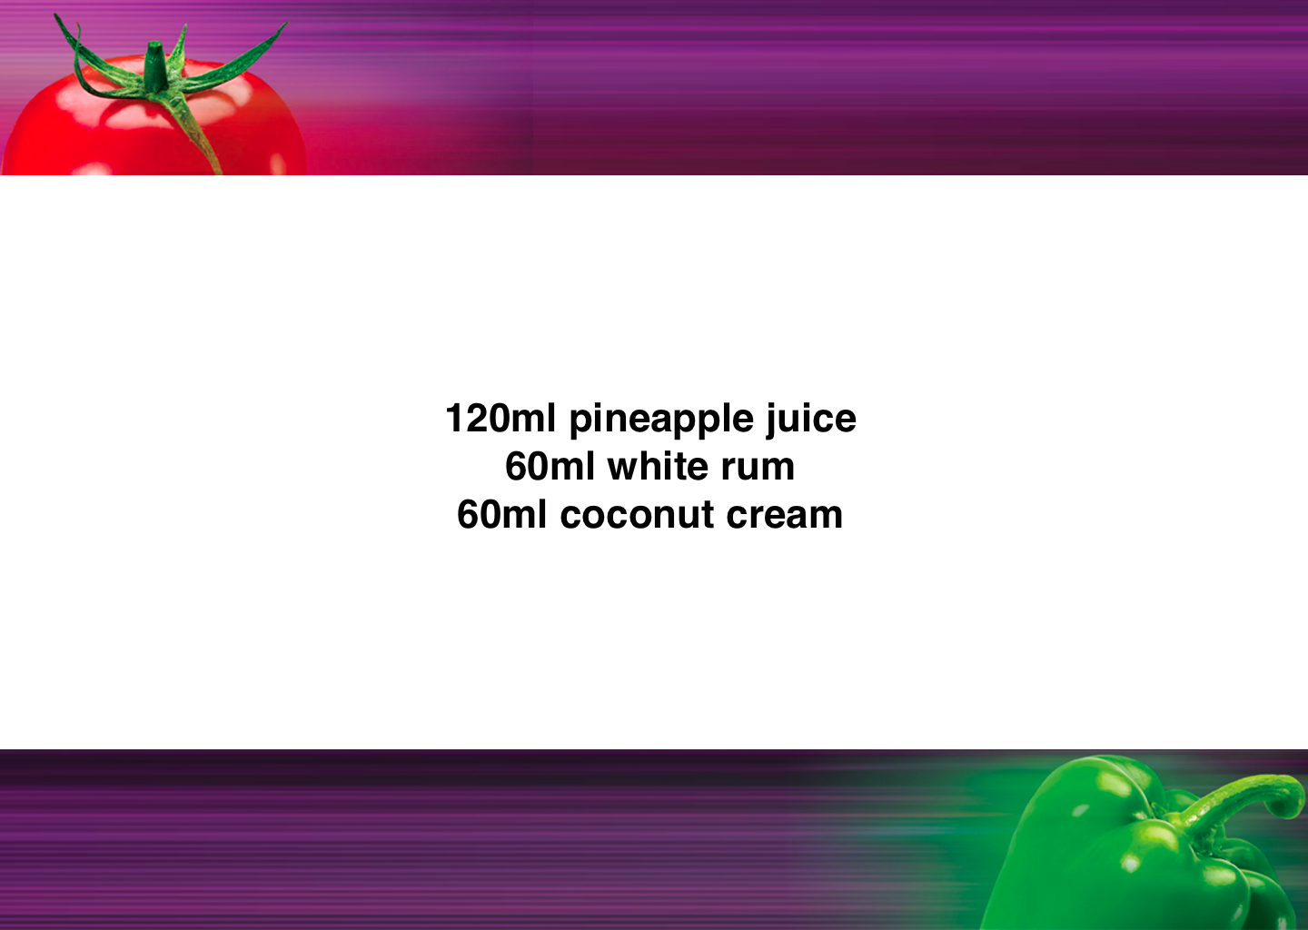

Slide 60
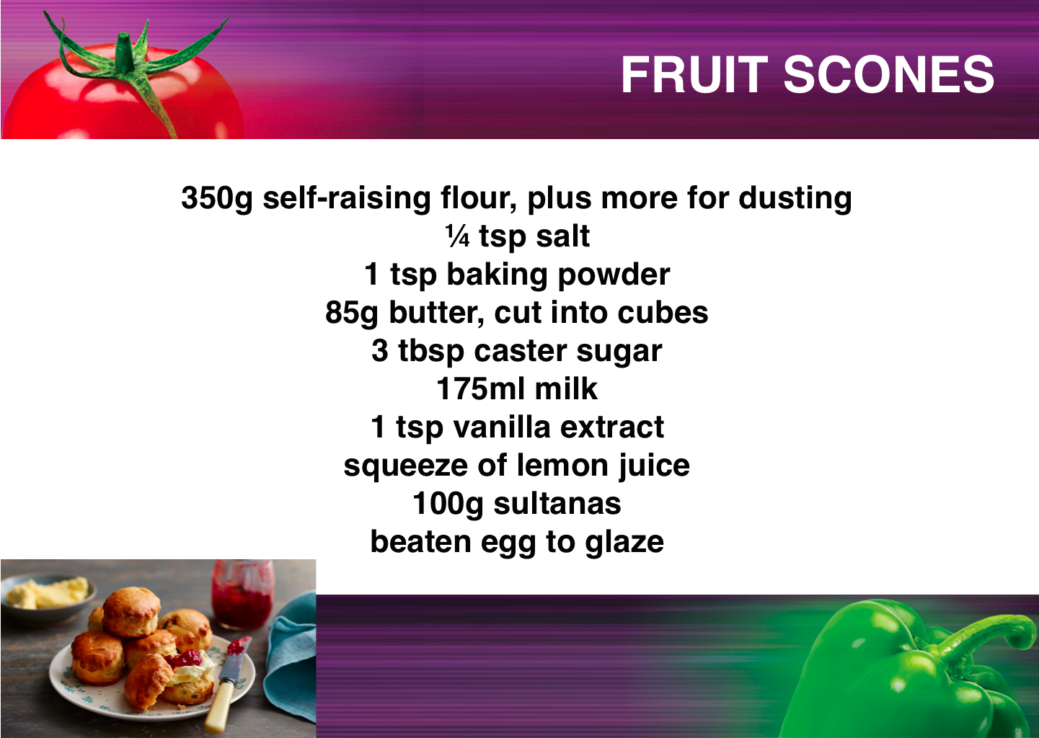

Slide 61
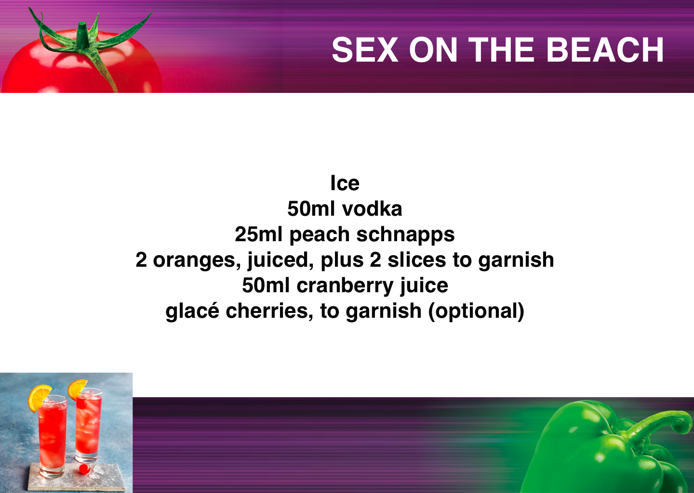

Slide 62
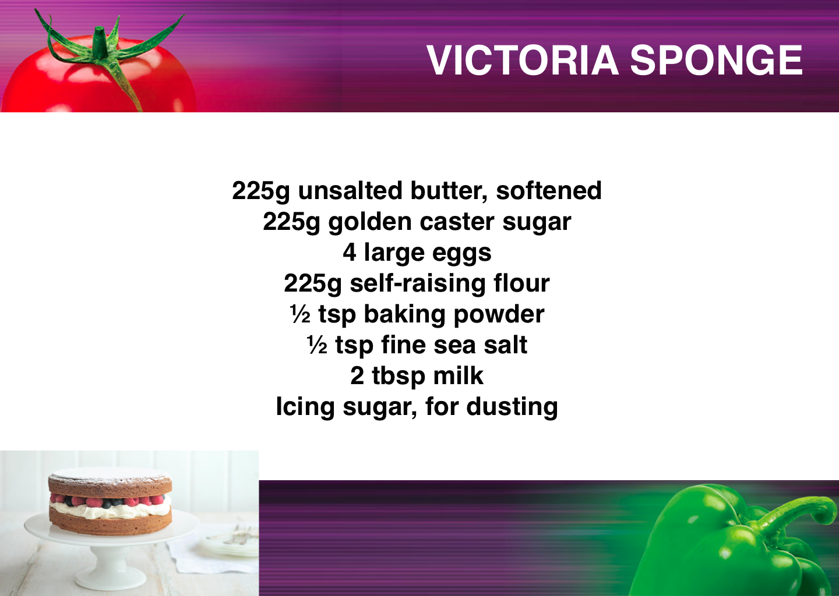

Slide 63
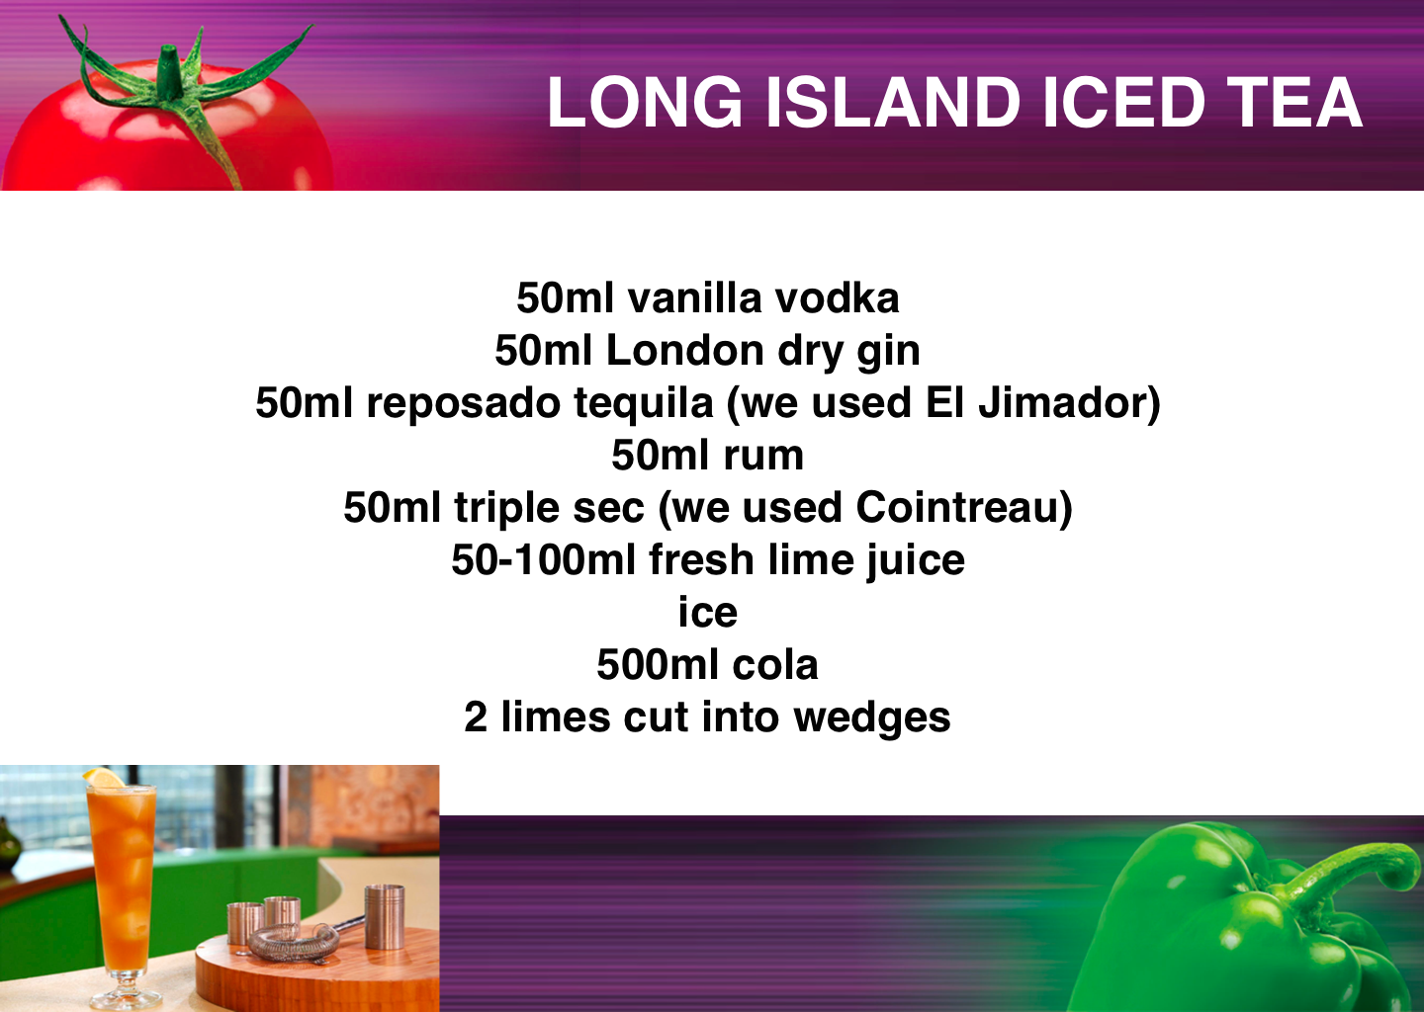

Slide 64
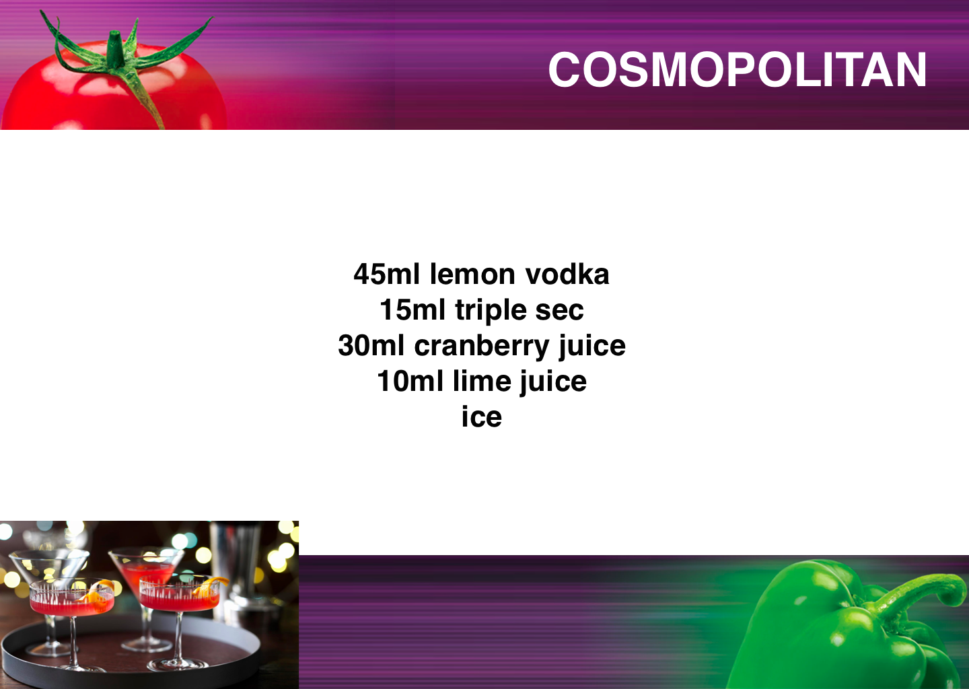

Slide 65
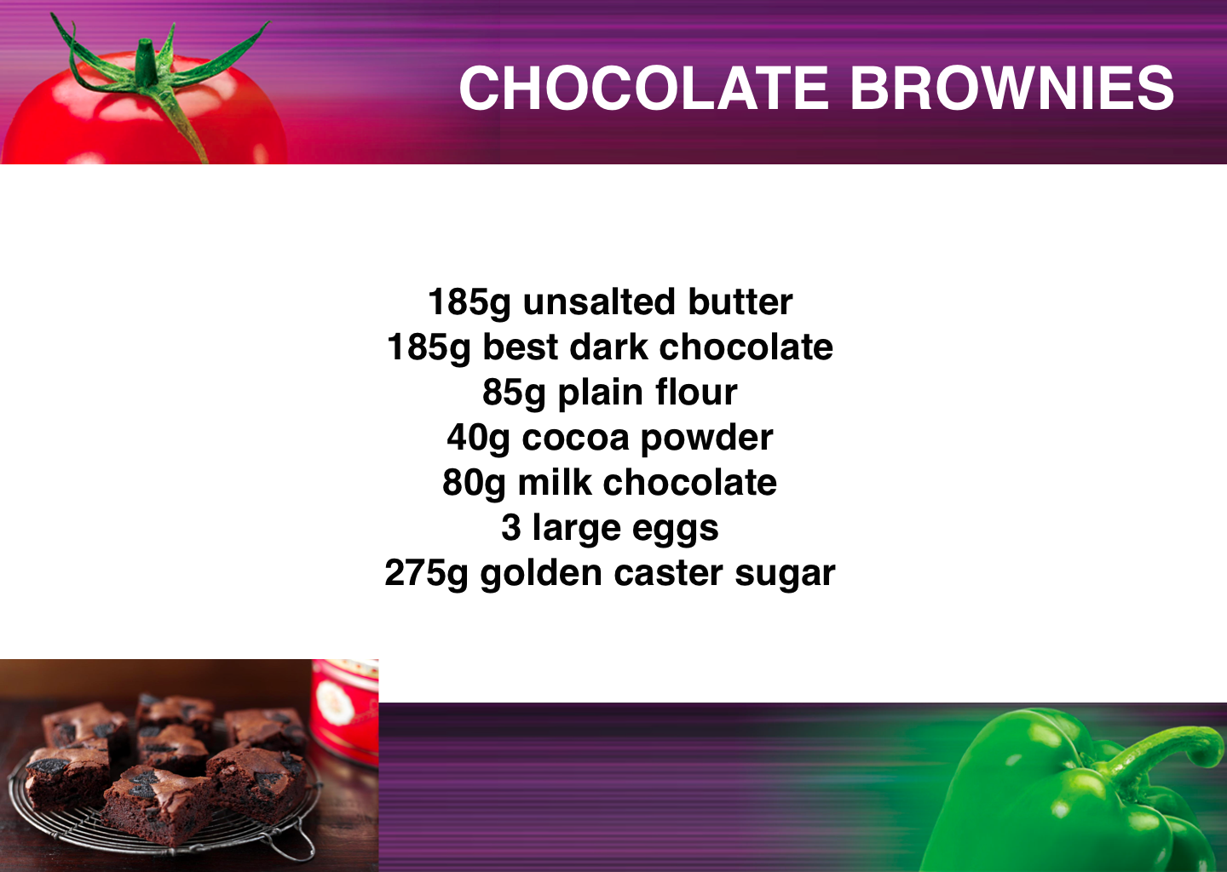

Slide 66
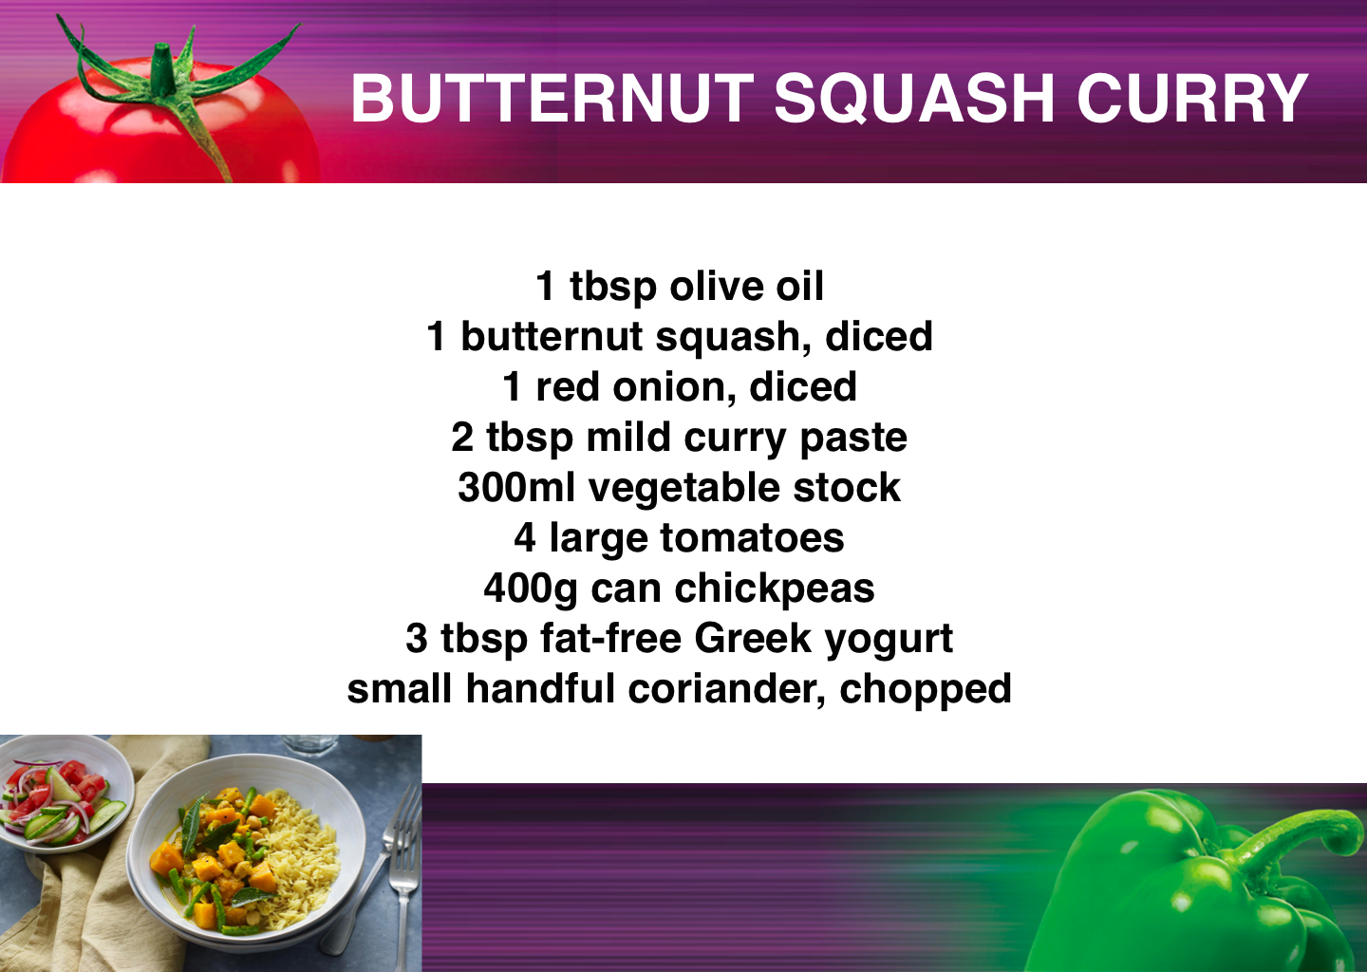

Slide 67
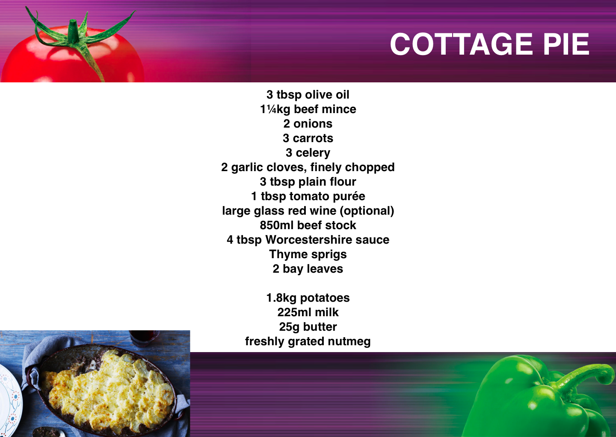

Slide 68
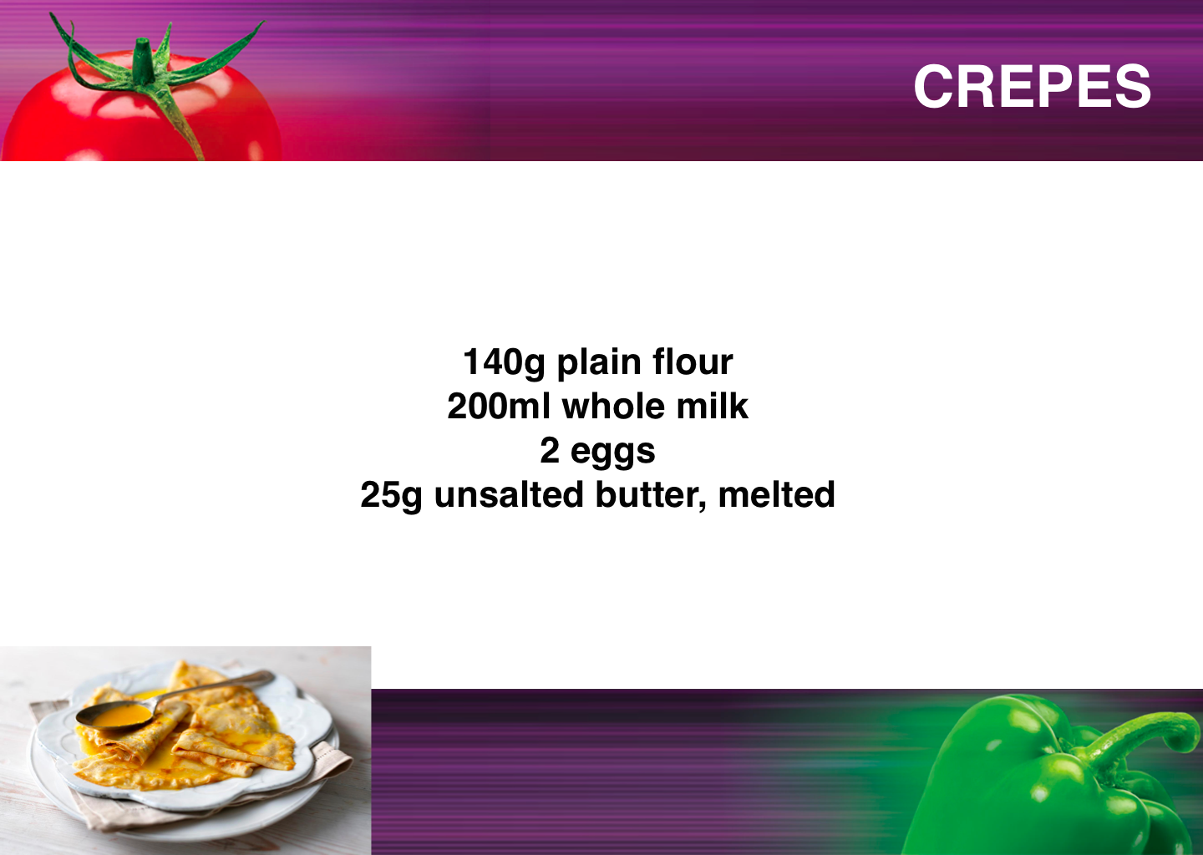

Slide 69
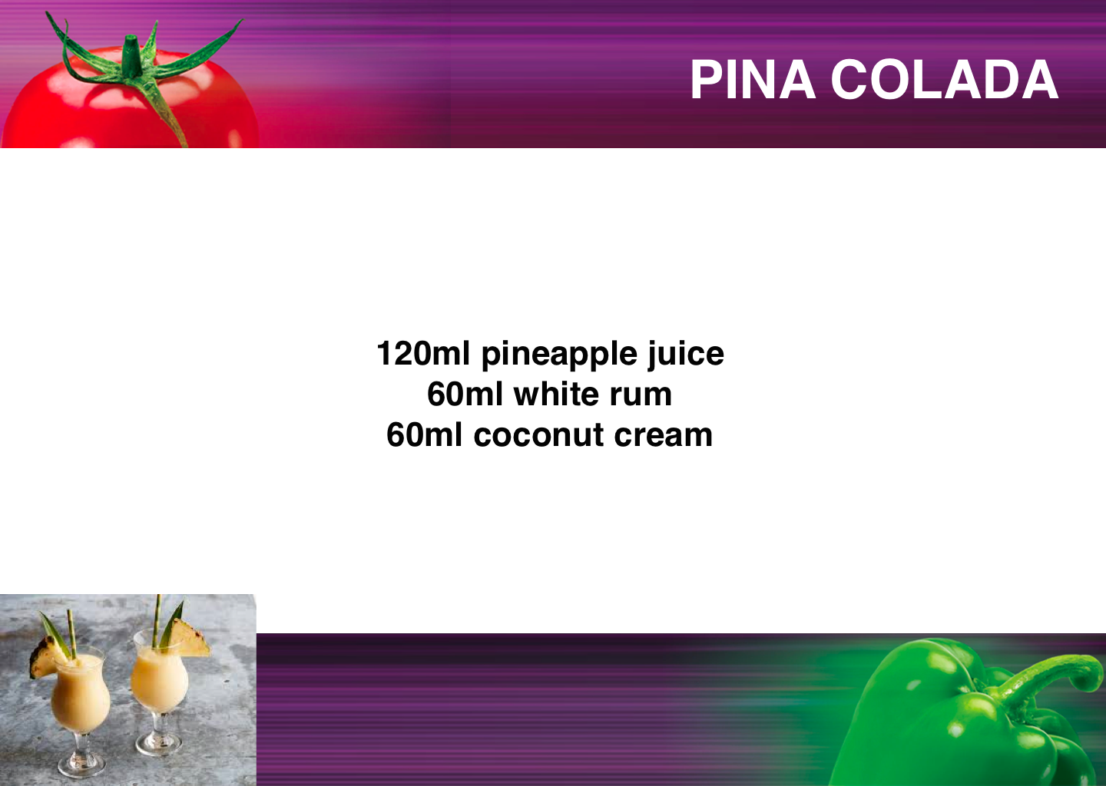

Slide 71


Slide 73
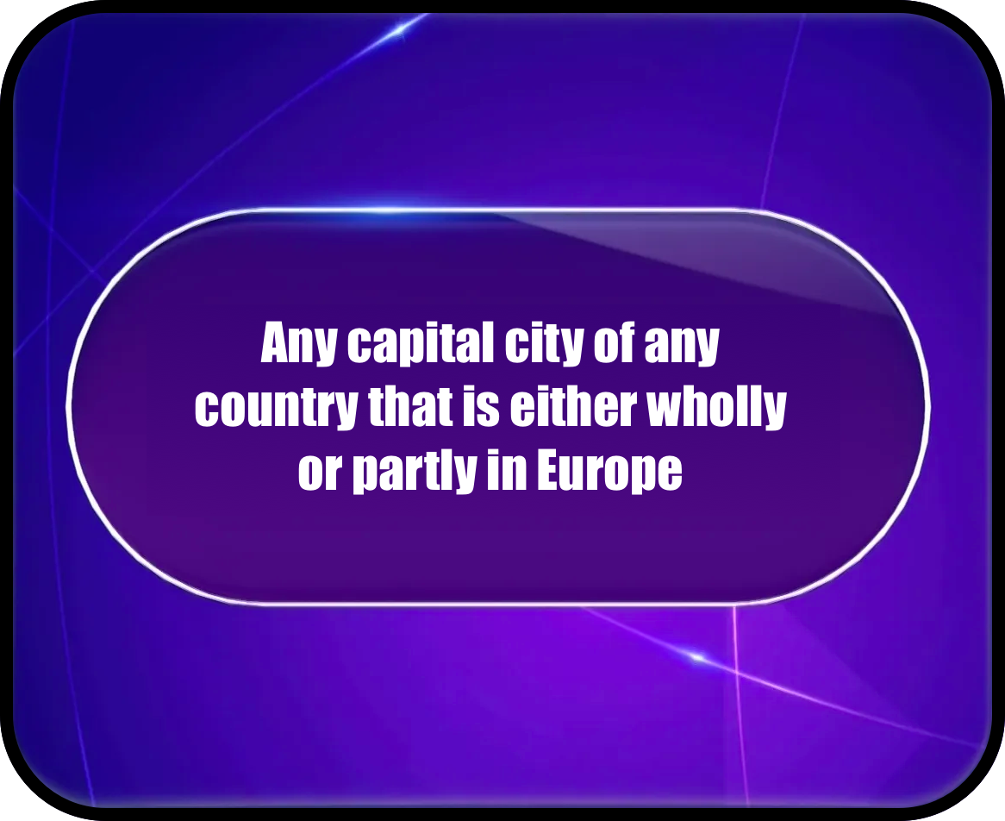

Slide 74
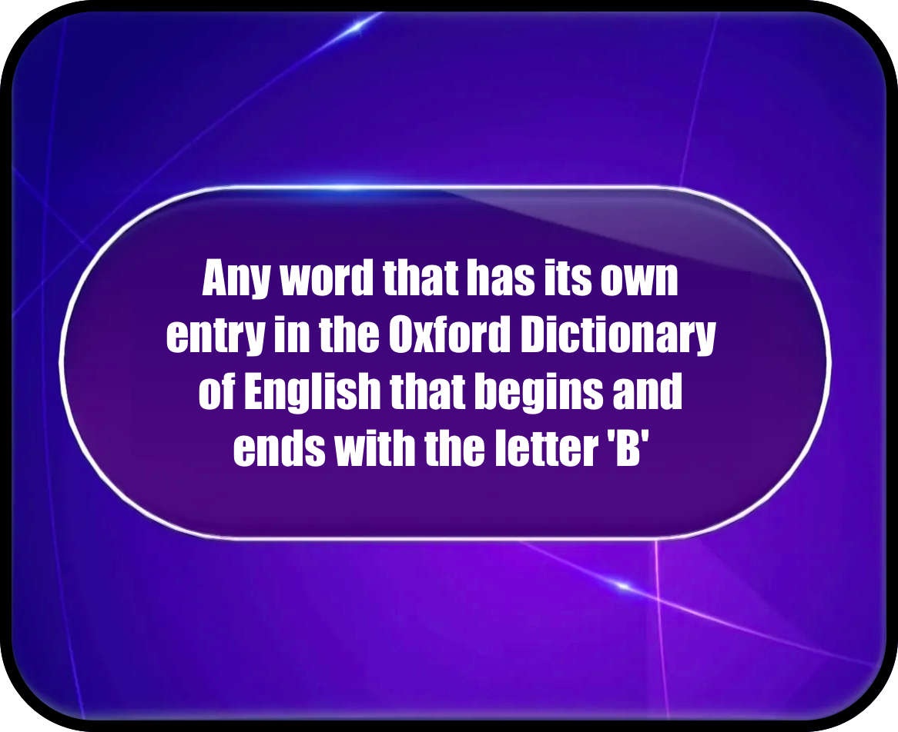

Slide 77
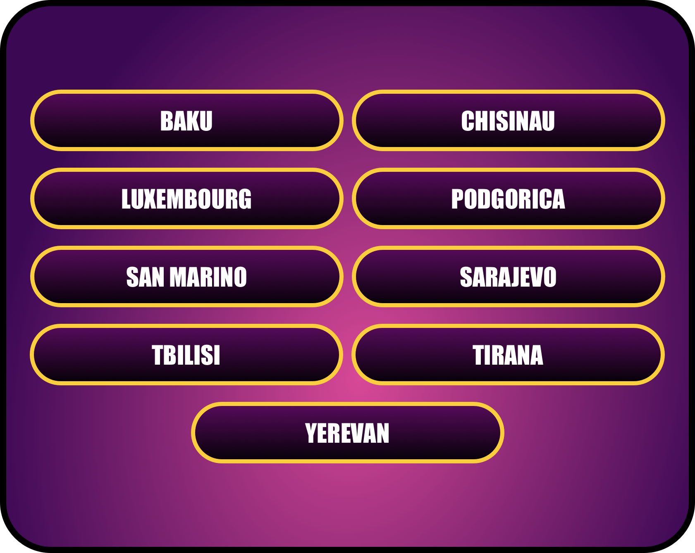

Slide 79
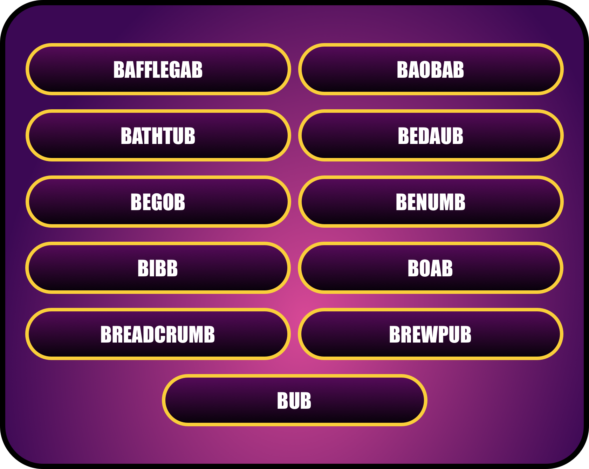

Slide 81
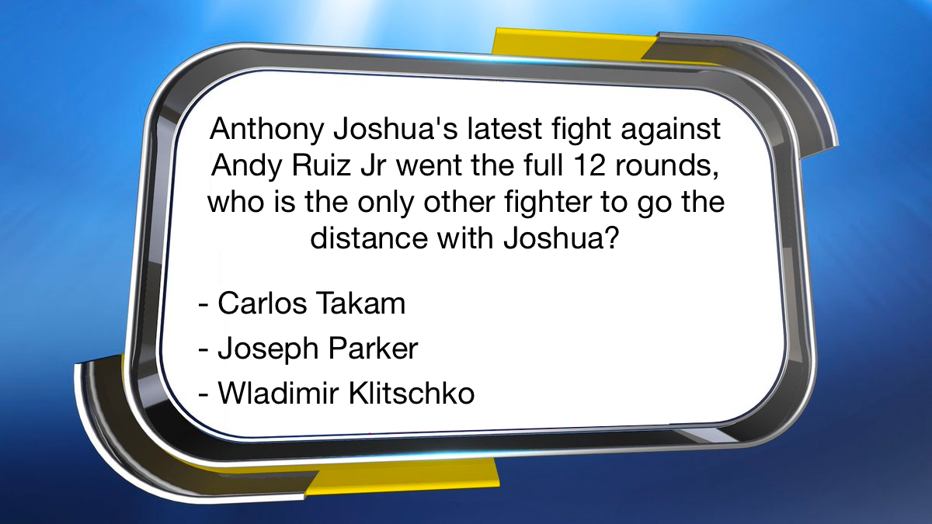

Slide 82
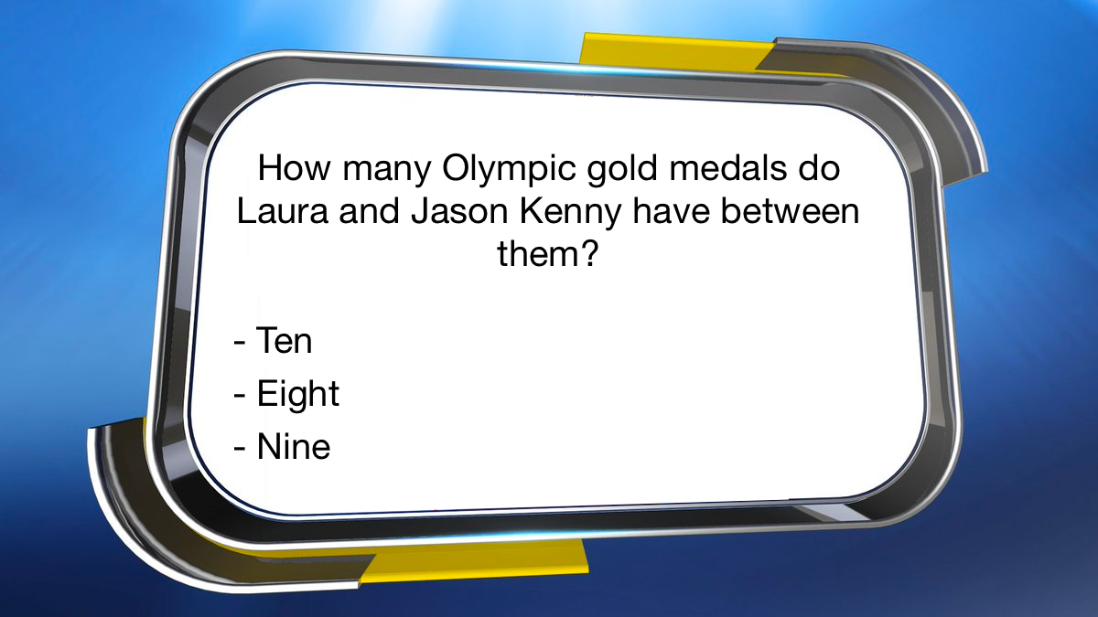

Slide 83
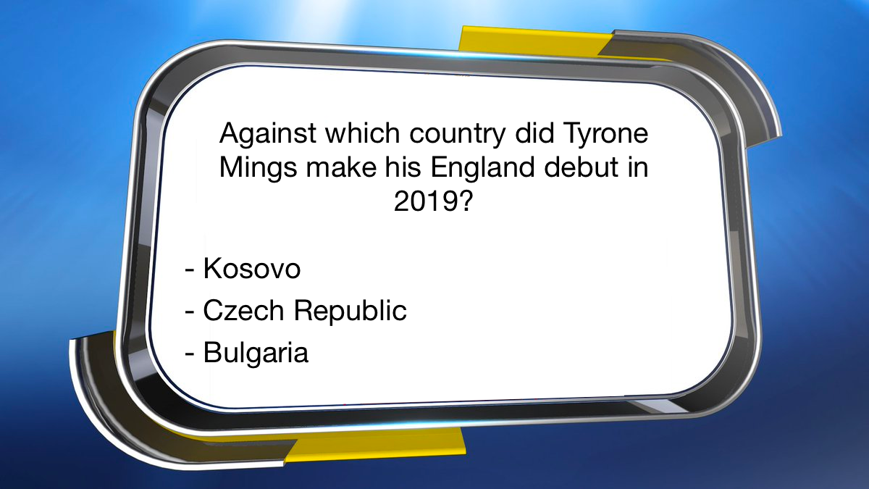

Slide 84
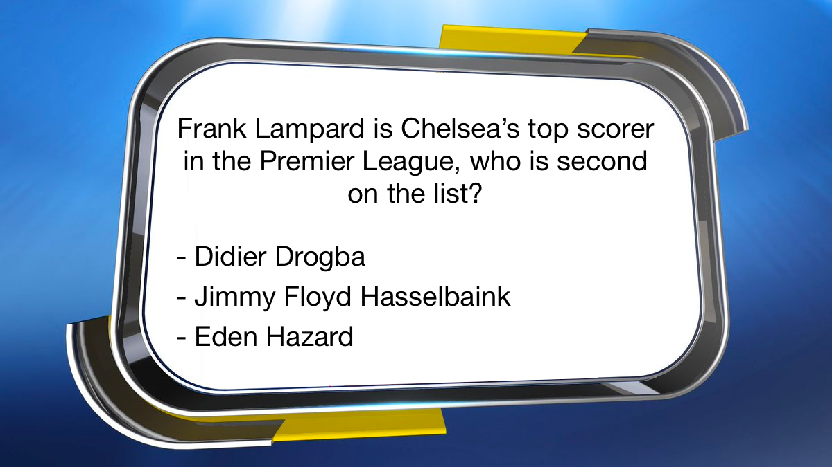

Slide 90
MASTERMIND

Slide 91
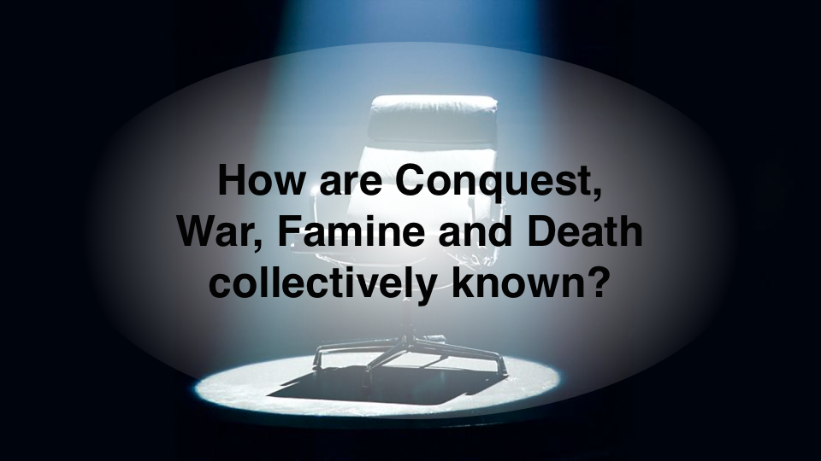

Slide 92
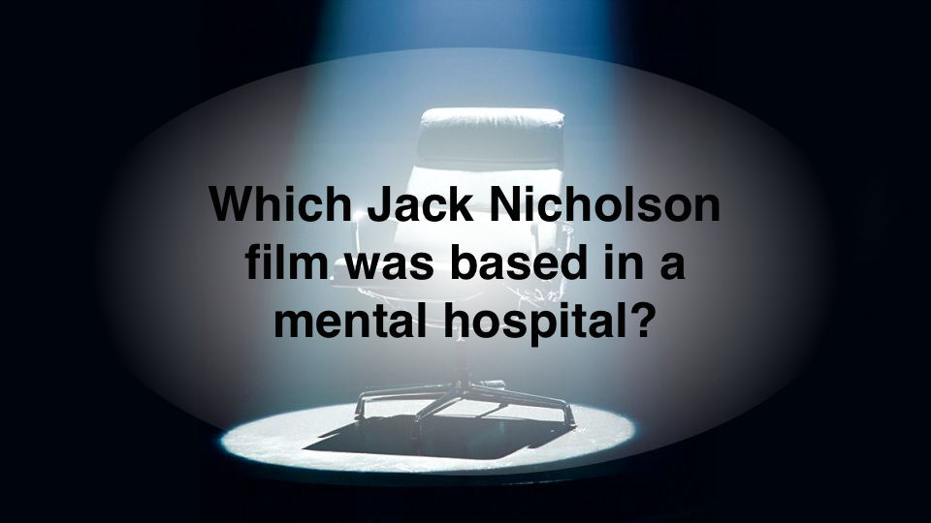

Slide 93
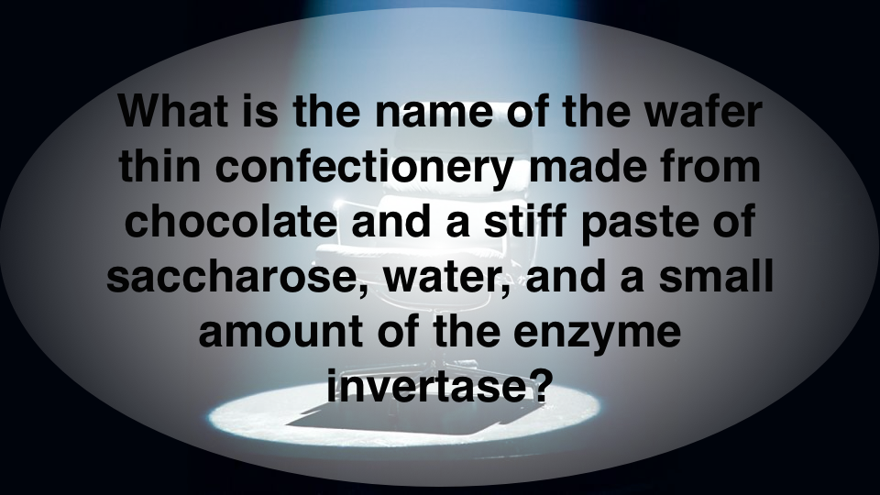

Slide 94
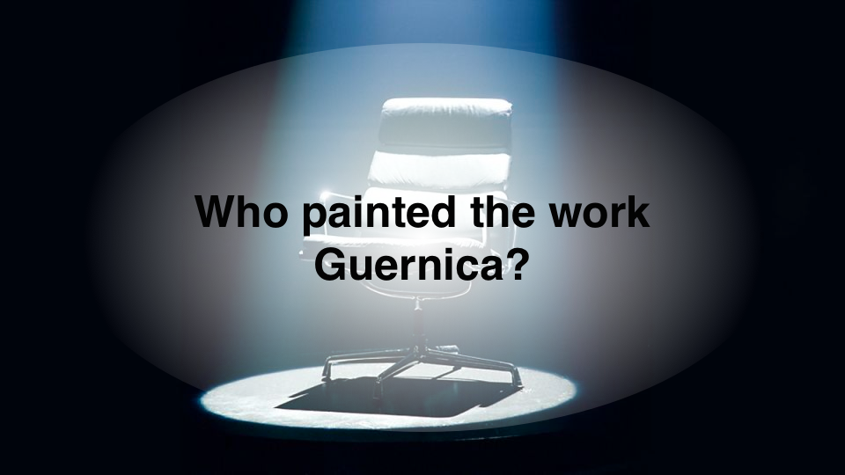

Slide 95
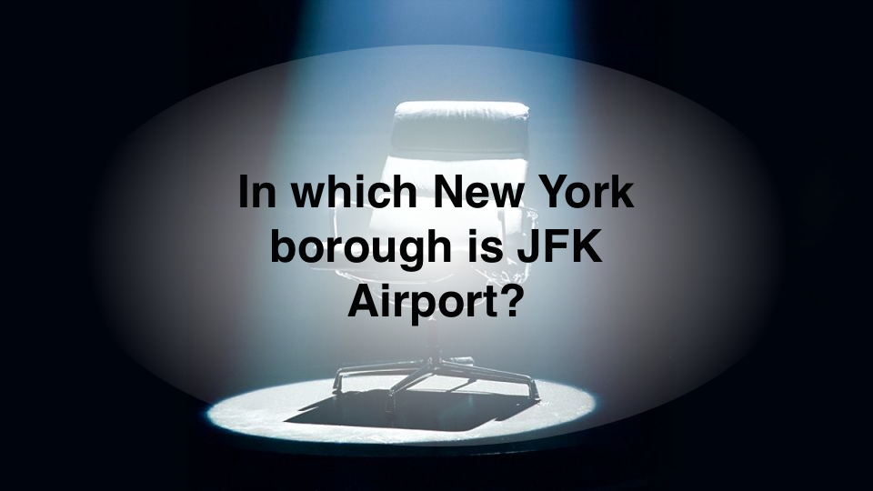

Slide 96
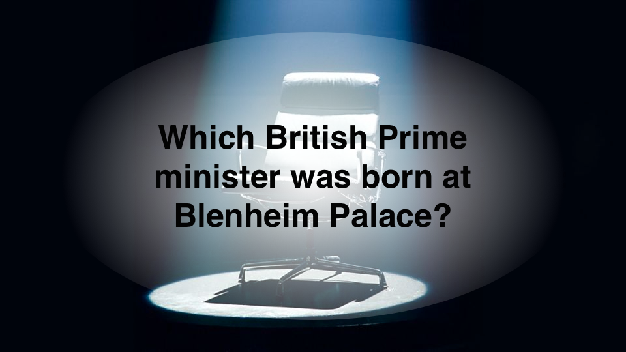

Slide 97


Slide 98


Slide 99


Slide 100


Slide 113


Slide 115


Slide 117

What links these 4 things?

Slide 118

What links these four things?

Slide 120
What links these 4 things?
They are all airports

Slide 121
What links these four things?
They can all be found on the moon

Slide 122


Slide 123


Slide 125


Slide 127


Slide 128


Slide 129


Slide 130


Slide 131


Slide 132


Slide 133


Slide 134


Slide 135


Slide 136


Slide 137


